Slide 1
Student Enrollment System
www.collaberadigital.com

Slide 2
Personal BACKGROUND
(Name, Past Experience, Qualification, Career Summary)
Name : Derryck Ramos
Past Experience : 3 months internship in Amkor Technology Philippines (developed an ASP.NET MVC application)
Qualification : Bachelor’s Degree in Computer Science
Career Summary : Fresh Graduate looking to further hone their programming skills and add more skills to their toolkit

Slide 3
Key Takeaways/Learnings from the Program (HTD)
Refreshed understanding on C#, SQL, and RDBMS concepts
More in-depth understanding of SDLC (particularly Agile development)
Updated knowledge on ASP.NET MVC
Learned a different way to access, configure, and manipulate SQL databases in .NET
Introduced to Identity Framework
Became more accustomed to version control with Git
Experienced how to create APIs for the first time
Finally learned something on the deployment end of the development cycle (introduction to Docker and Kubernetes)

Slide 4
Problem Statement of the Capstone Project
Enrollment in college has always been a hassle, between all the paperwork one had to fill out and all the offices one had to visit. A lot of processes are still done by hand, and what few online solutions exist leave something to be desired in terms of performance or user experience.
This project aims to answer the question of whether it is possible to create a Student Enrollment System where the process of adding and dropping classes is quick and easy for the student.
What is the most convenient way for administrative staff to add information regarding the classes the students can enroll?
How can the process of searching for, adding, and dropping classes be streamlined?

Slide 5
Approach Note
Detailed an exhaustive list of functions required of the system and documented them in a business requirements document
Illustrated aforementioned functions as well as required database entities with diagrams for use as a visual guide in development
Construct a mockup of the desired look of the system with static HTML
Actual development of application with ASP.NET MVC 6
Configured Identity Framework to enable authorization based on login
Added Student and Administrator roles
Configured the main database and established all the relationships between entities
Developed the repository functions that facilitated the creation, retrieval, updating, and deletion of data for each and every table in the database
Created corresponding controllers and views that utilized said functions
Tested each function and ensured various validations were in place
Configured authorizations with respect to user roles for pertinent controllers

Slide 6
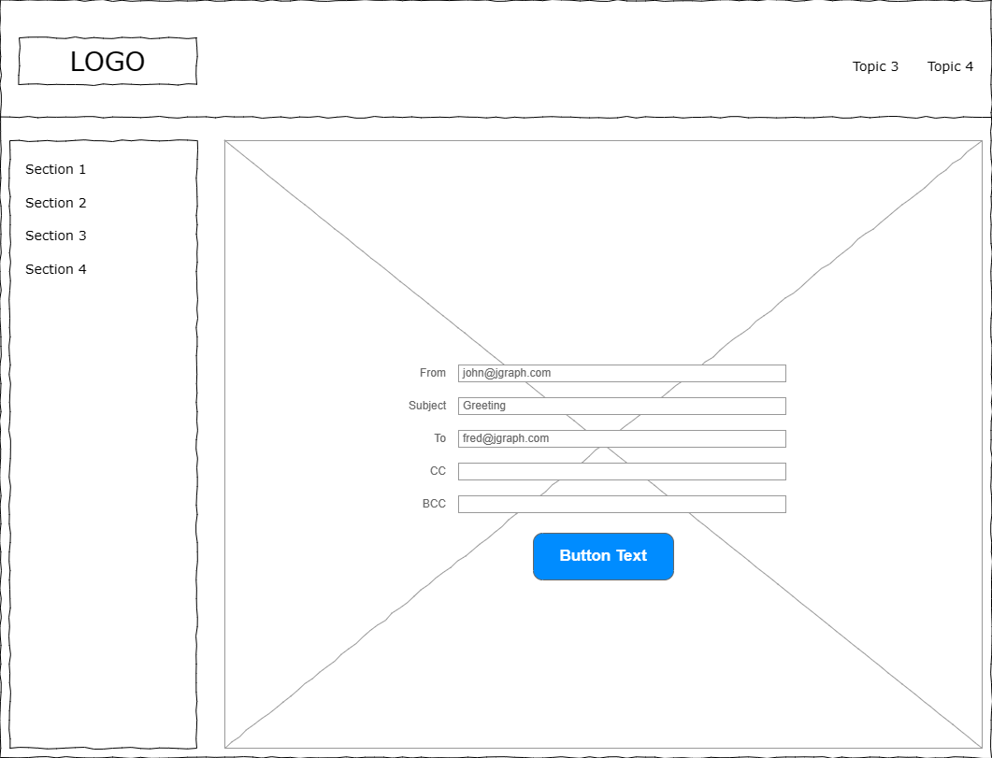
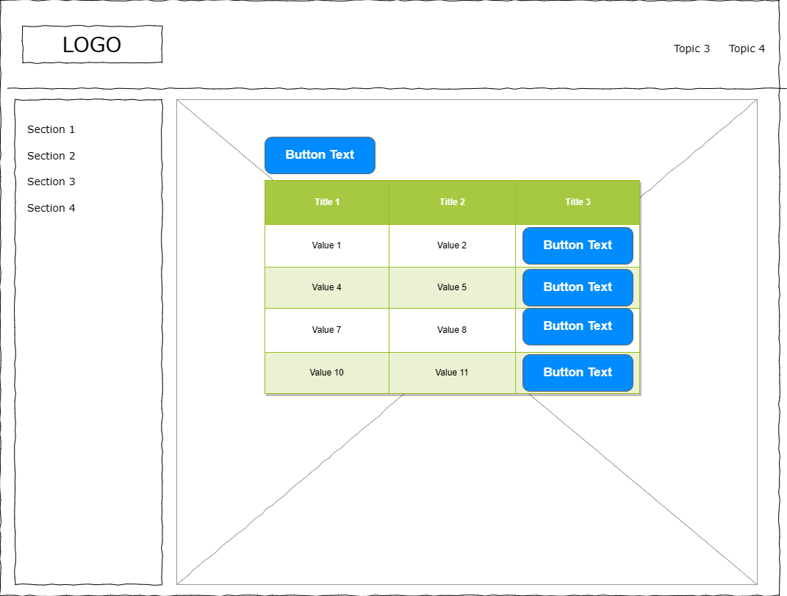
Wireframe/Architecture

Slide 7

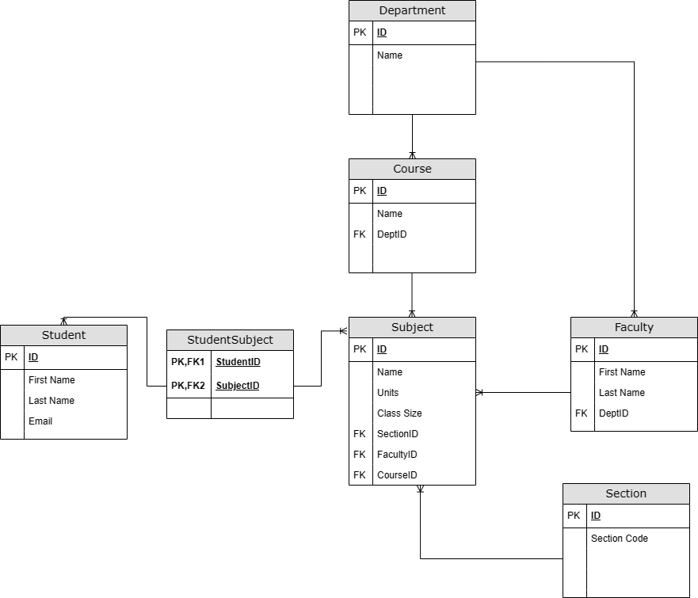

Wireframe/Architecture
www.collaberadigital.com

Slide 8
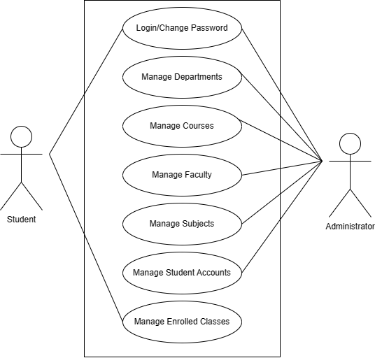
Wireframe/Architecture
www.collaberadigital.com

Slide 9
Important areas of the Project with screenshots
(Frontend, Database, Backend, Key Validations, Functionalities Etc.)
www.collaberadigital.com

Slide 10
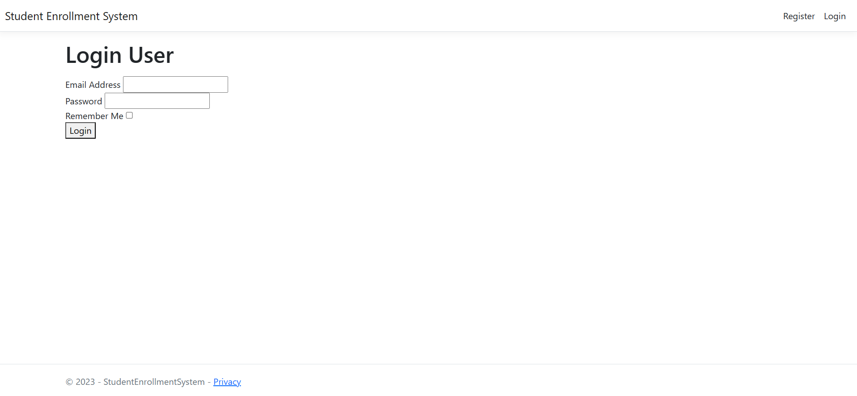
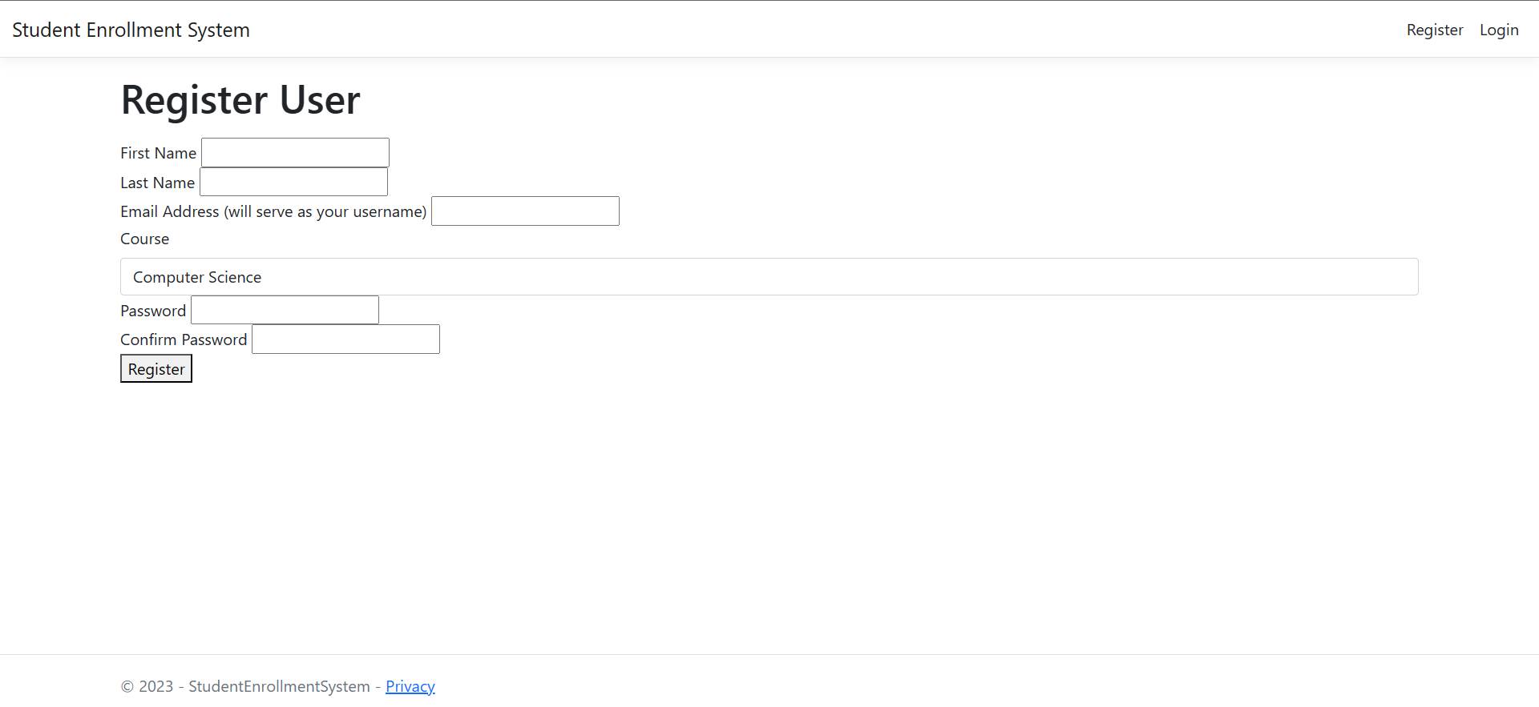
Important areas of the Project with screenshots
Login/Register

Slide 11
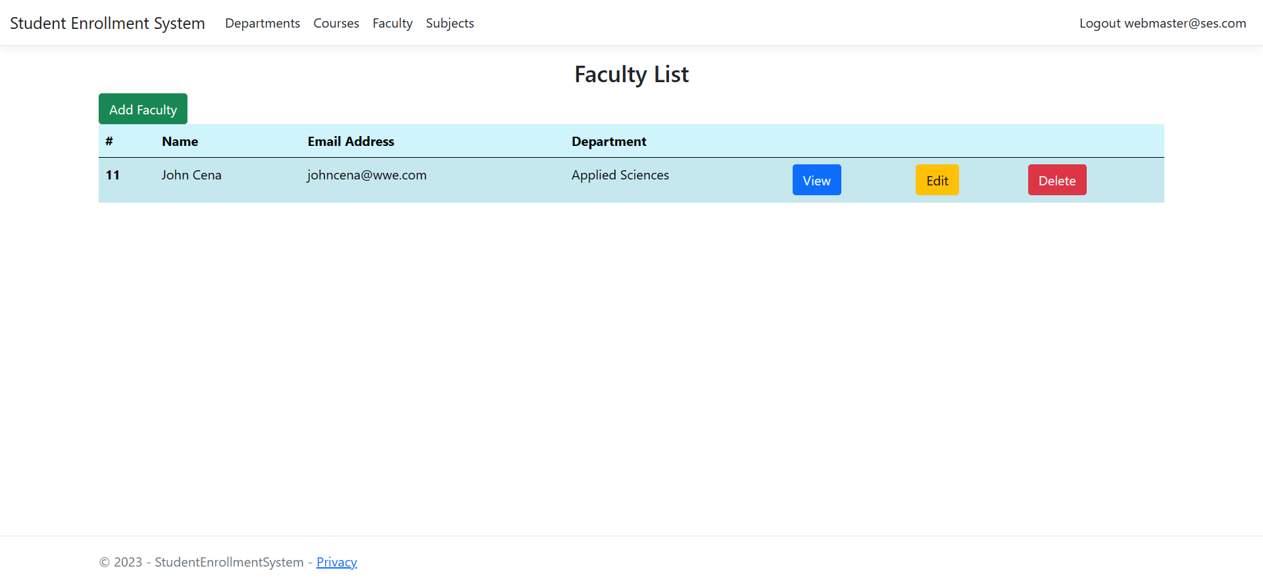
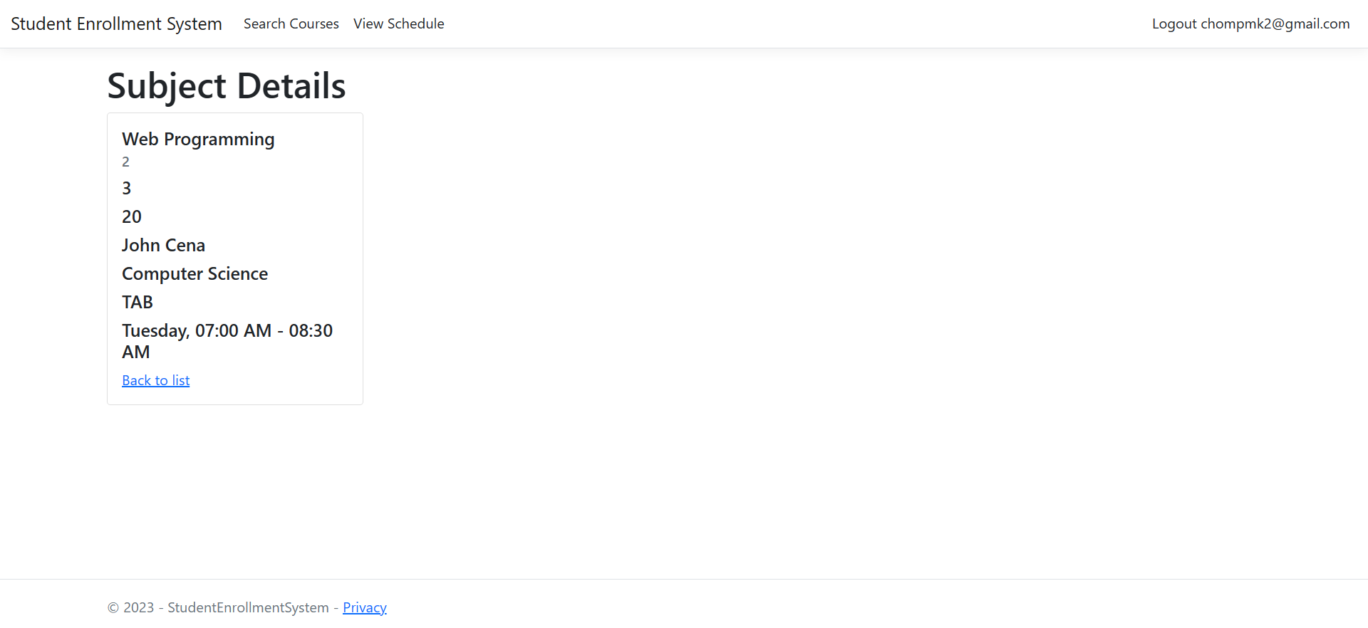
Important areas of the Project with screenshots
Admin: Database Management

Slide 12
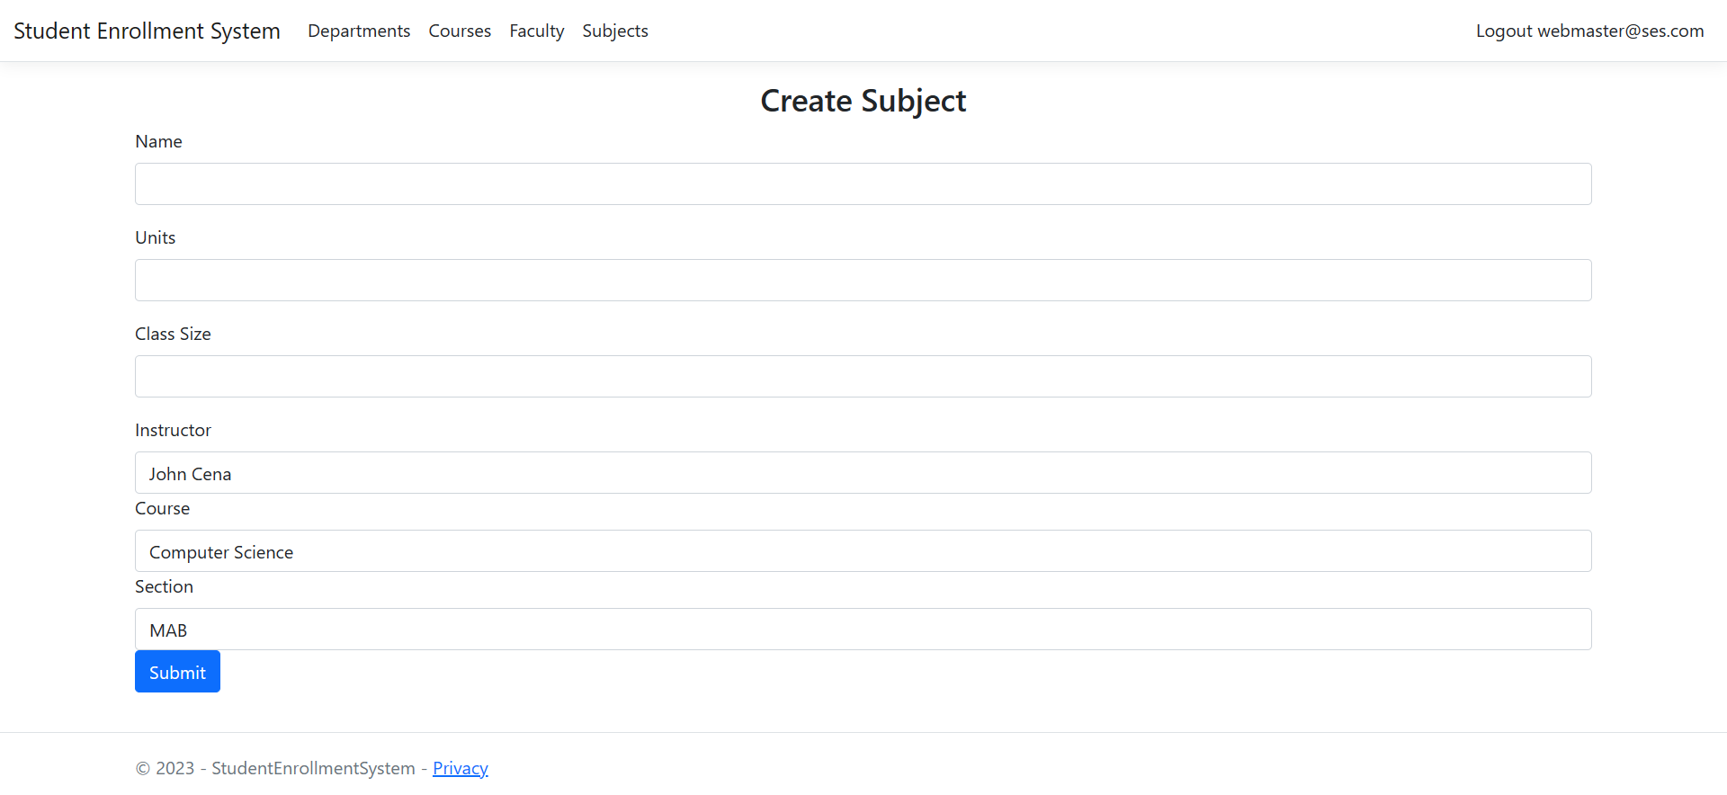
Important areas of the Project with screenshots
Admin: Database Management

Slide 13
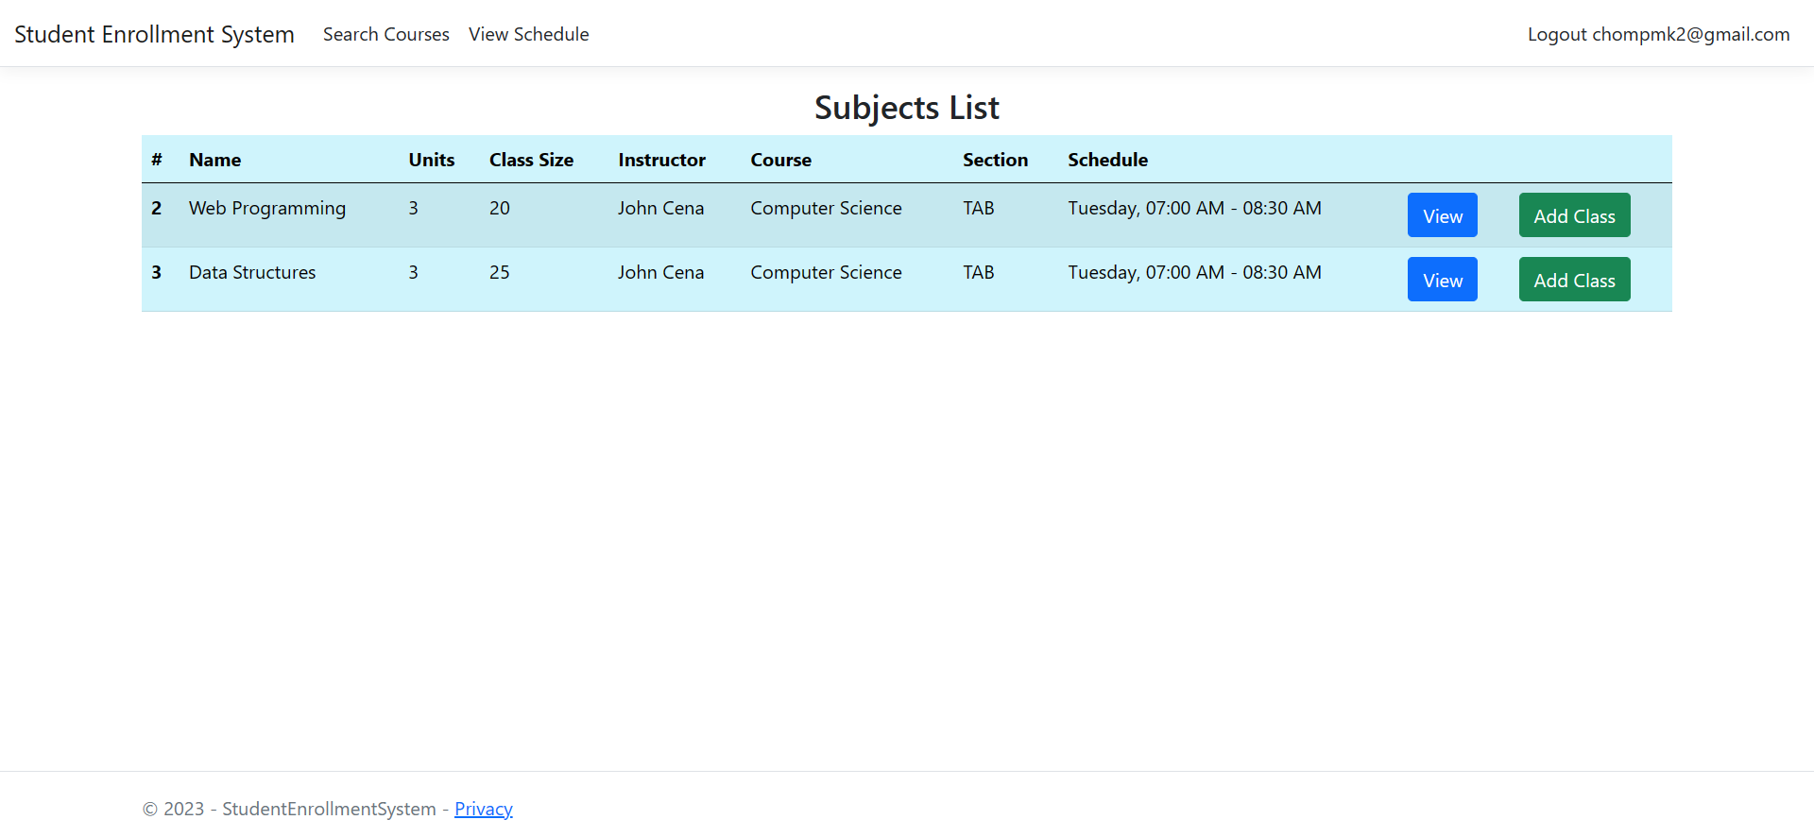
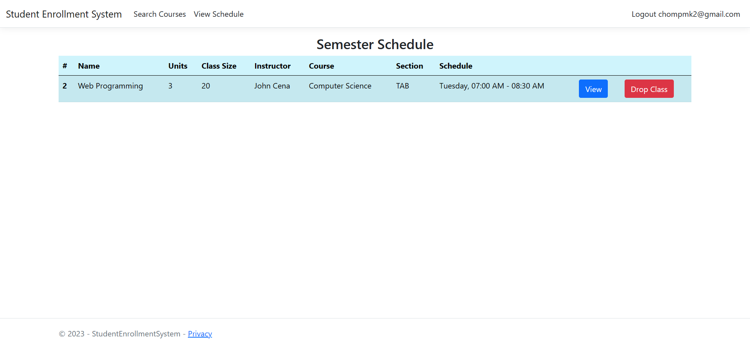
Important areas of the Project with screenshots
Student: Enrollment Functions

Slide 14
Known Issues/Features Still in Progress
Reset password page is missing
Remove registration page, make account creation an administrator function
Polishing various UI elements
Additional functions for ease of use (search bars, pagination)
Adding confirmation dialog for certain functions (updating/deleting data)
Docker containerization of project
Deployment of project via Kubernetes

Slide 15
Conclusion
The final product sufficiently demonstrates that a student enrollment system that is intuitive to use can be developed
Creating all pertinent information for a class is a simple matter of filling out a short form
Viewing, editing, and deleting existing information is easily accessible in one place
Students can enroll and drop classes with a single press of a button
Such a system won’t necessarily completely alleviate the stress that comes from enrollment, but having at least one process handled swiftly the way this does is bound to save a lot of people headaches.

Slide 16
Recommendations (Future Enhancements)
Implement means to export student enrollment information for use in other systems (e.g. tuition calculation, pre-enlistment)
Add restrictions such that enrollment is only allowed during a specific period at the beginning of a given semester
Expand user base to include faculty members, permitting them to view students in their class and select which classes they will teach
Replace current account management with a single sign-on feature that makes use of university email address

Slide 17
Thank You
www.collaberadigital.com

